Slide 1
Journeysmith: The Future of Worldbuilding
Team Members: Luke de Vries, Noro Dung, William Elsen, Saron Melesse, Nathan Schultz, Chase Velloney

Slide 2
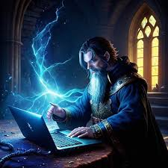
Vision
Easy information access
Custom pins and placements
Easy to learn
Free
Simple UI without unnecessary features
Cross-platform compatibility

Slide 3
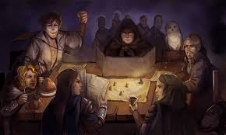
Demonstration

Slide 4

Database Format
Dungeon Master(ID, nickname, loginID, password)
Map(ID, DungeonMasterID, MapImage, MapName, supermapID)
Note(ID, WorldMapID, Content)
Pin (ID, NoteID, x, y, color, icon)

Slide 5


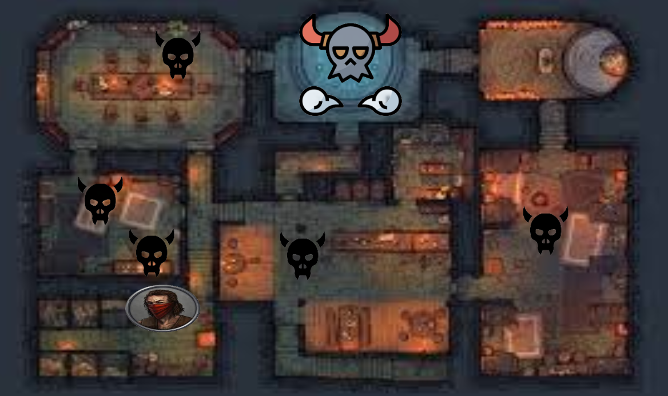
Features in Progress
Sub-maps
Player icons
Player stats
Login screen

Slide 6
Question and Answer
while time < 2: #minutes
if hasQuestion() == True:
askQuestion()
else:
BREAK
time += 0.5 #minutes

